Slide 1
Math Essentials for Data Science
Land Belenky
Galvanize Denver, 2018

Slide 2
Resources:
Galvanize Open Source Website:
https://galvanizeopensource.github.io/math-essentials-for-data-science
These Slides:
http://bit.ly/Land_math
Contact the Instructor:
Land Belenky: ljbelenky@gmail.com

Slide 3

Overview
.
Day 1
Scalars, Vectors and Matrices
Matrix Operations
Linear Algebra I
Day 2
Linear Algebra II
Matrix Decomposition
PCA and SVD
Day 3
Distances
Similarities
Calculus

Slide 4
Day 1 Objectives:
Become familiar with basic data structures
Scalar
Vector
Matrix
Tensor
Become familiar with python (numpy) tools to handle these

Slide 5
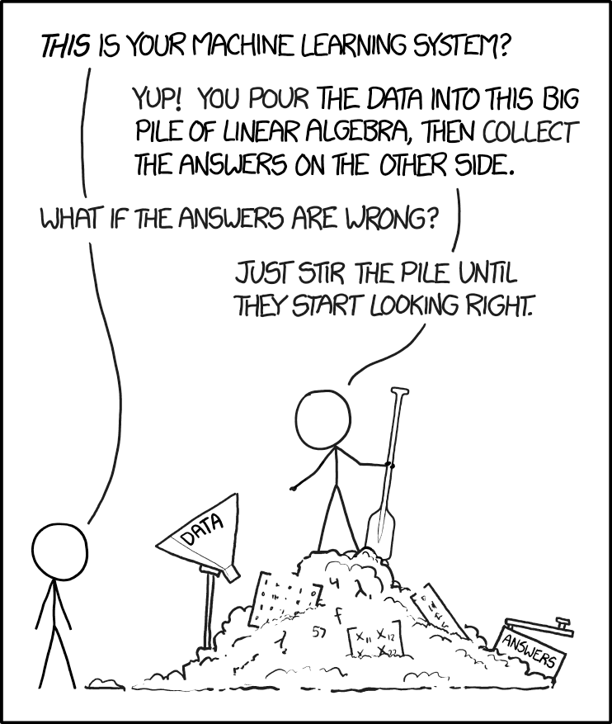
Notes:
The inputs to machine learning systems are often, nearly always numpy arrays (or other data types interchangeable with numpy arrays such as images, pandas dataframes, csv files) The output of a ML model is often not a single answer, but a “trained model” which is a set of calculations. The ‘under-the-hood’ calculations in ML are often numpy array functions A big issue in ML is knowing when you’ve gone too far in fitting. With more than 2 input variables, it is often difficult to visualize data or appreciate it intuitively, therefore we need to become familiar with the numeric representations of matrices

Slide 6
Some basic definitions:
Scalar:
A single number
May have any value (positive or negative)
Does not have a direction

Slide 7
Some basic definitions:
Vector:
A group of numbers (scalars)
May be a row or a column
Order of the numbers is important as they correspond to different dimensions

Slide 8
Vector (and non-vector examples):
Measurement of weights of every kid in class
Height, Weight, Age, Cholesterol Data for heart patients
MLS data for houses

Slide 9
Matrix:
A 2-Dimensional collection of scalars
(e.g. a spreadsheet)
Position is important
By convention: rows x columns (m x n)
May be square or rectangular
May be tall or wide
May not be ragged (missing data filled with NaN)

Slide 10
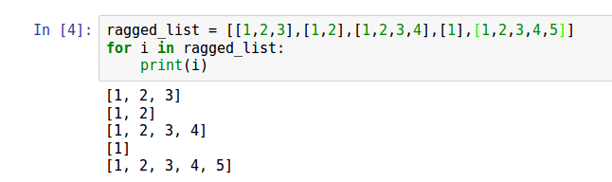
Example of a Ragged List:
Allowed in python, not numpy

Slide 11
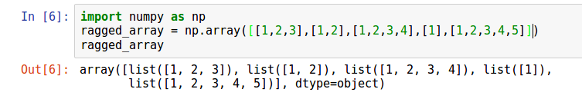
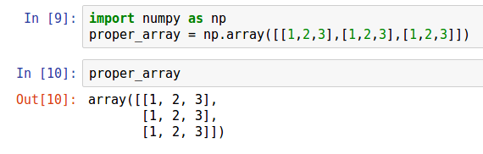
If you try to make a ragged array:
A proper numpy array:

Slide 12
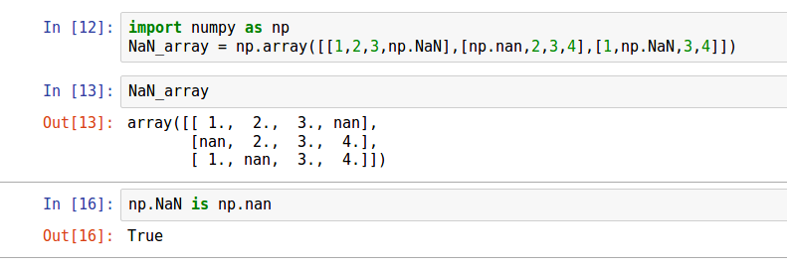
Use np.NaN (Not a Number) to fill missing values:

Slide 13
Tensor:
A collection of scalars with more than 2 Dimensions
(e.g. a workbook of spreadsheets)
Position is important
Rank: is the number of dimensions
Again: may not be ragged; missing data filled with NaN

Slide 14
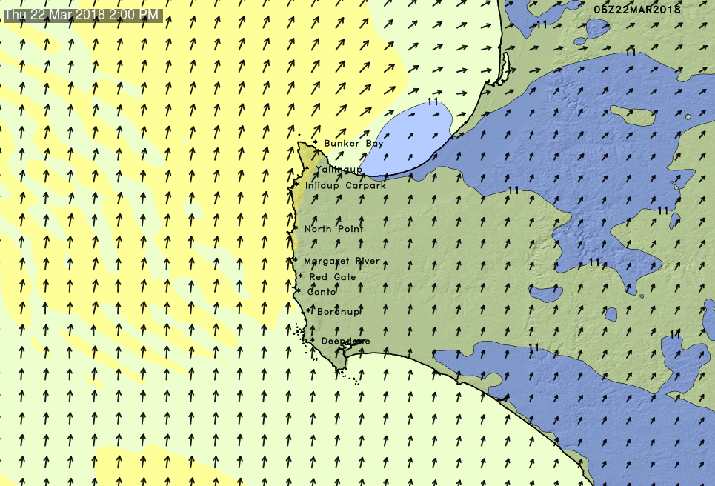
Rank Examples:
Just looking at the arrows, not the image

Slide 15
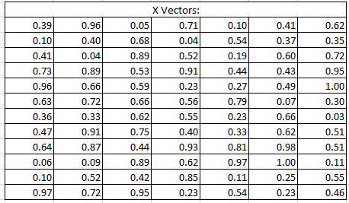
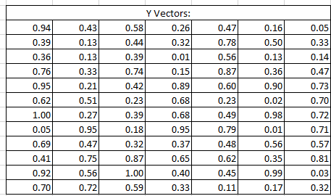
Rank of Wind Chart = 3 (Row, Column, Page)

Slide 16
Going Back for a moment:
Workbook = Tensor of Rank 3
Matrix = Tensor of Rank 2
Vector = Tensor of Rank 1
Scalar = Tensor of Rank ???

Slide 17
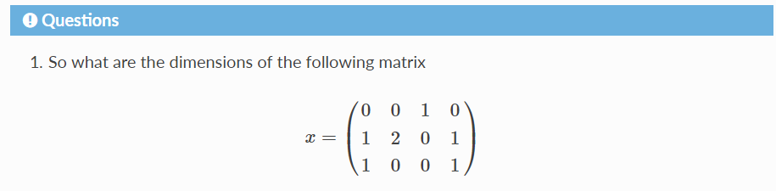

Slide 18
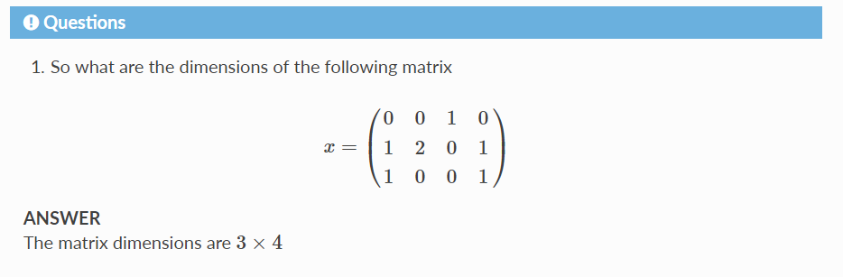

Slide 19
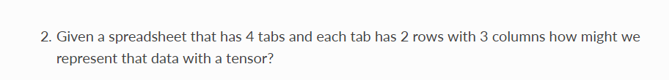

Slide 20
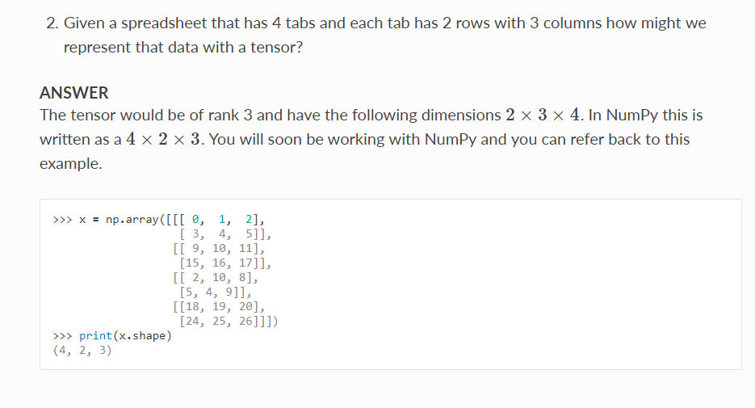

Slide 21
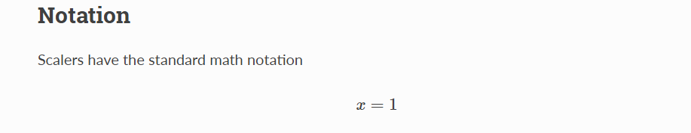

Slide 22
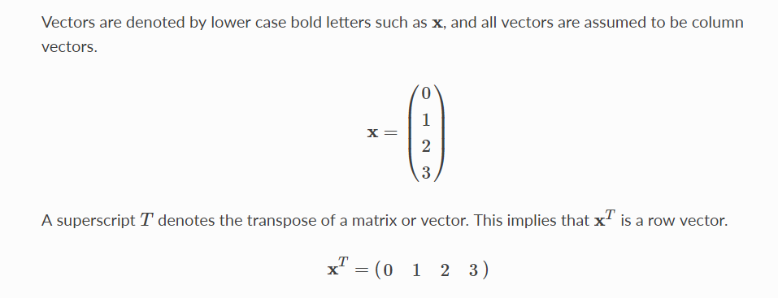

Slide 23
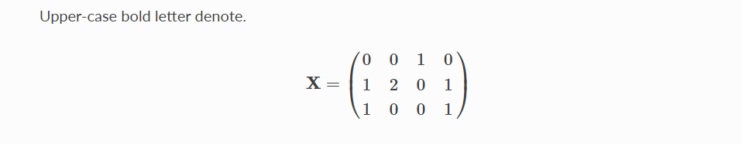

Slide 24
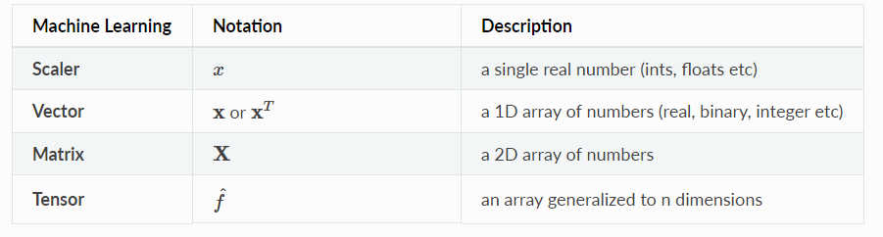

Slide 25
Numeric Python: numpy
Standard with all python distributions
You can do it in python without numpy, but it is slow, difficult, memory-inefficient and allows you to make errors

Slide 26
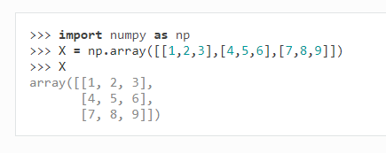

Slide 27
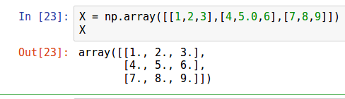
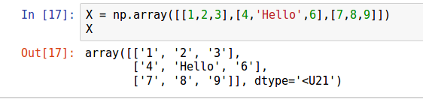
Automatic selection and conversion of data type:

Slide 28
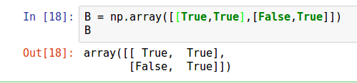


Slide 29
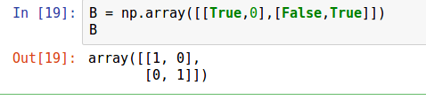

Slide 30
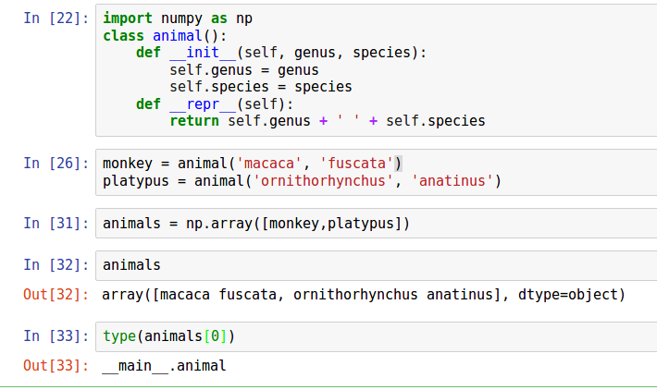
Numpy array can be of any data type (even objects):

Slide 31
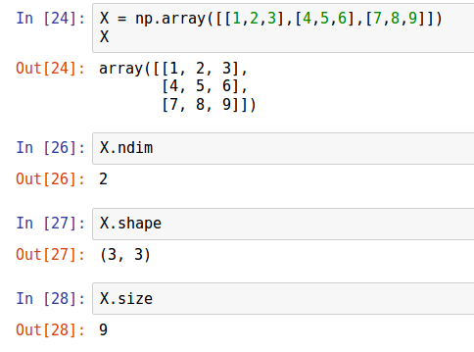
Common useful attributes:

Slide 32
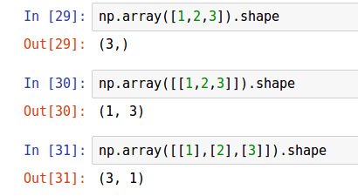
Notice the use of double brackets:

Slide 33
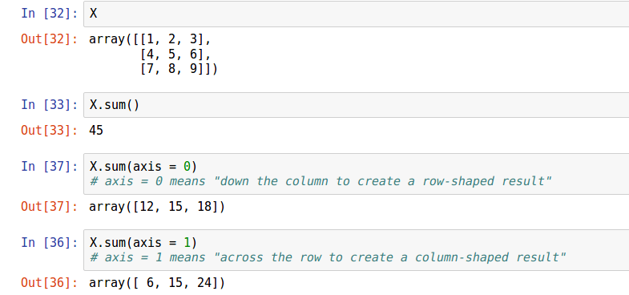
Array Methods:

Slide 34
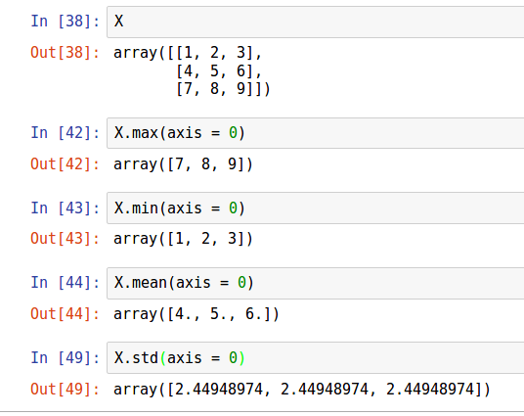

Slide 35
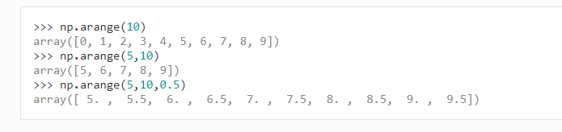
np.arange(start, stop, step_size)
Note: “start” is included but “stop” is not
Defaults to start = 0, step = 1

Slide 36
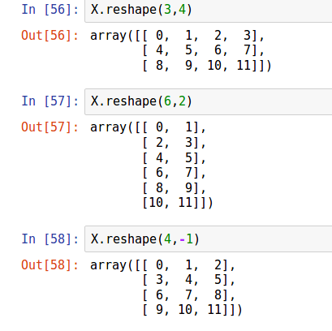
array.reshape(rows,columns)

Slide 37
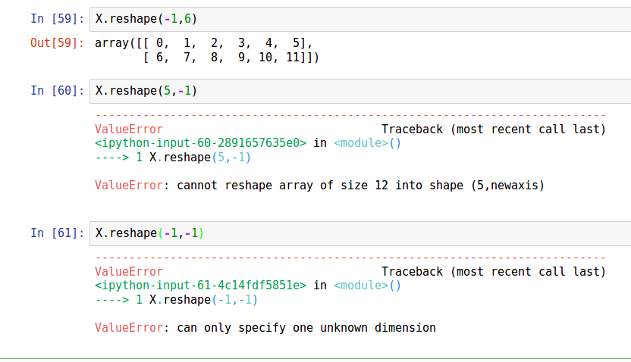

Slide 38
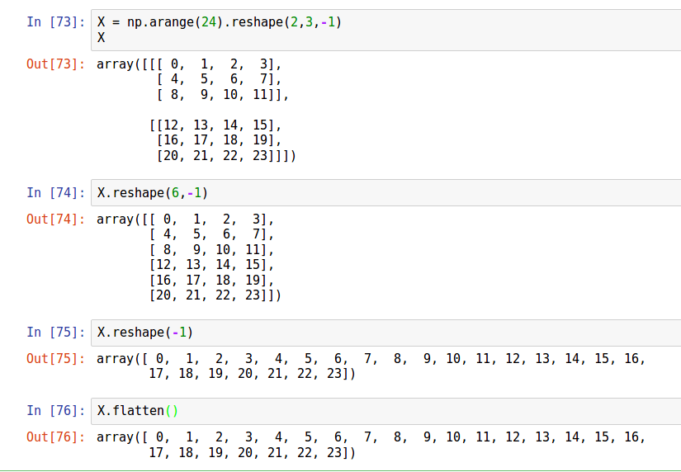

Slide 39
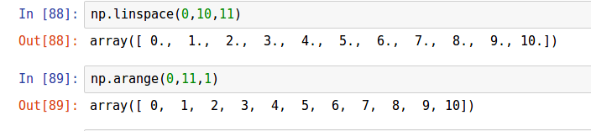
np.linspace(start, stop, number_of_elements)
Similar to arange, but inclusive on both ends and number_of_elements rather than step_size:

Slide 40

np.logspace(log[10](start), log[10](stop), number_of_elements)

Slide 41
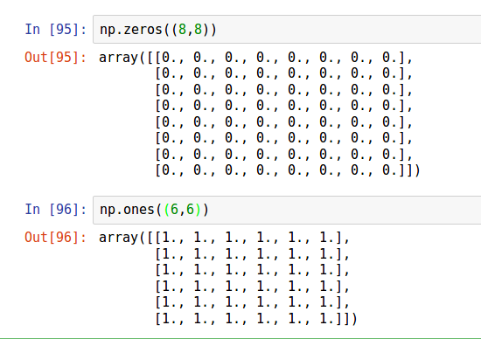
Convenient ways to make arrays:

Slide 42
How would you make the equivalent of an np.sixes() method?

Slide 43
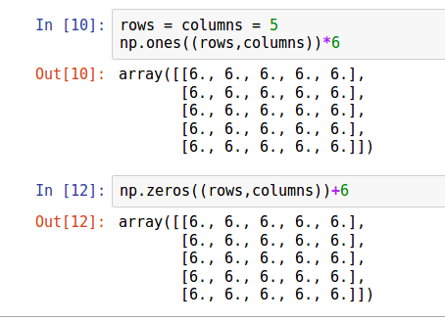
How would you make the equivalent of an np.sixes() method?

Slide 44
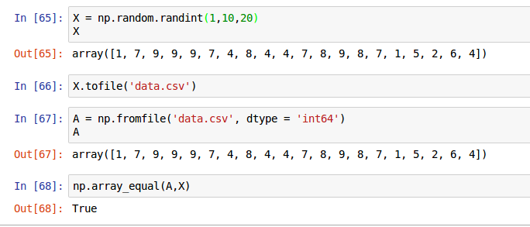
Load and Save Data

Slide 45
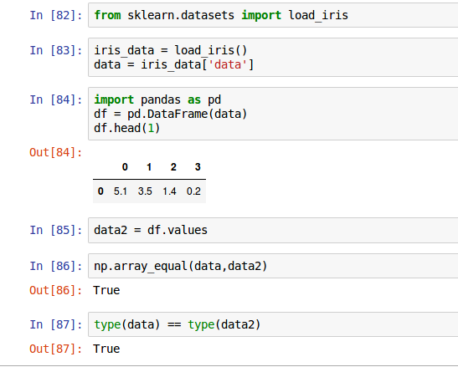
To Pandas and Back:

Slide 46
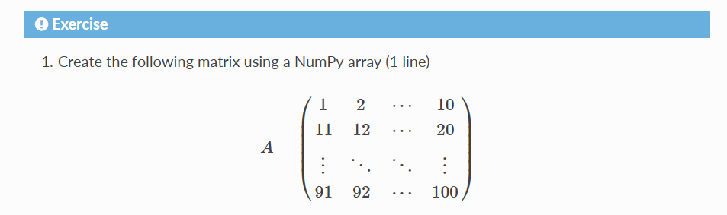

Slide 47
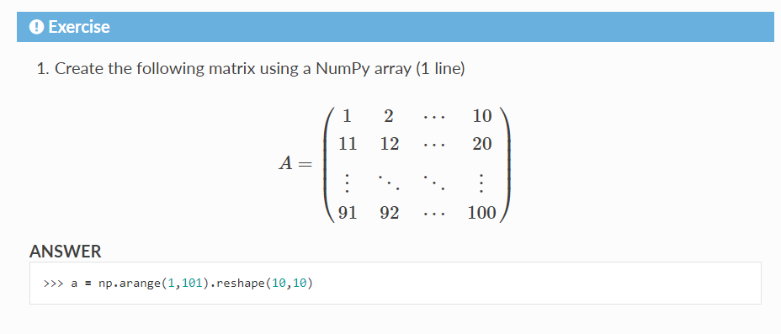

Slide 48


Slide 49
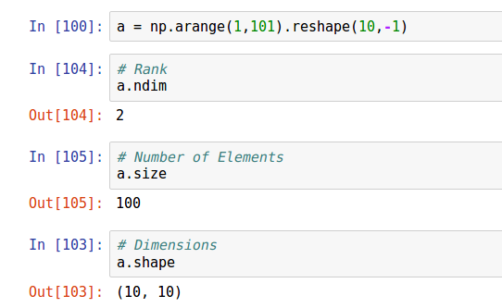

Slide 50


Slide 51
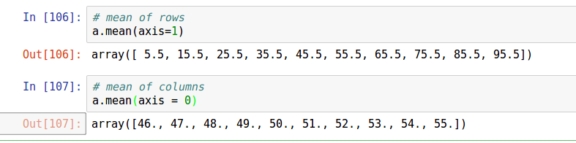

Slide 53
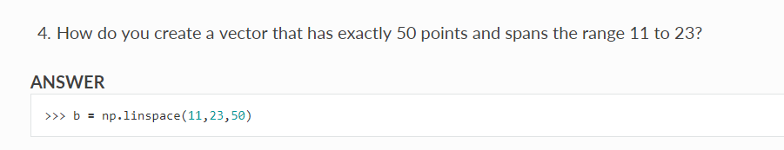

Slide 54
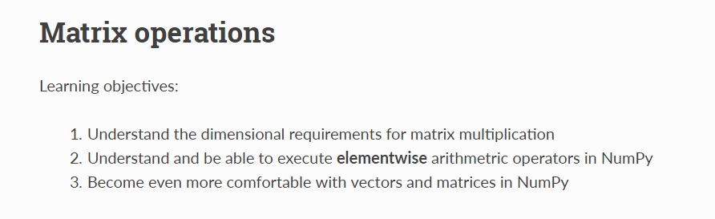

Slide 55
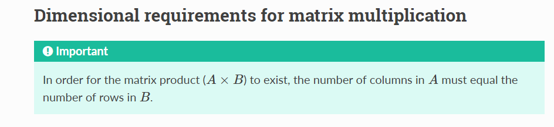

Slide 56
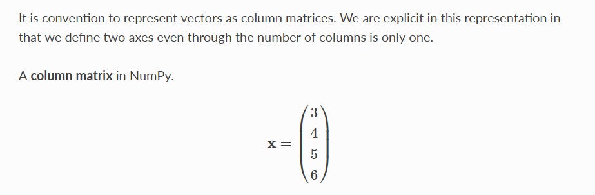
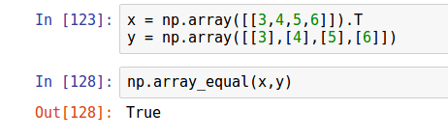

Slide 57
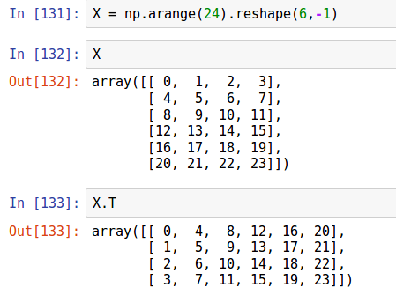
A brief aside about Transpose:
Transpose changes a column vector into a row vector or vice versa.
For a matrix, it swaps row and columns (changing from tall to wide or vice versa)

Slide 58
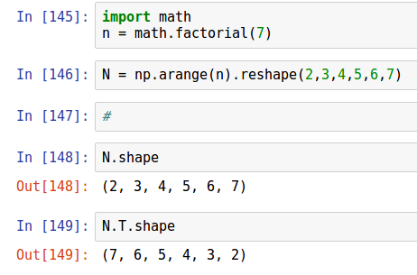
For more complicated tensors, Transpose reverses the dimensions:

Slide 59
A Machine Learning Example:
Supervised Learning -- predicting an output from a set of inputs
Suppose we have a set of input variables (X) that describe Colorado and we want to predict snowfall from these.
X is composed of a set of vectors (x) which each describe one feature (elevation, latitude, average winter temperature, historical snowfall data, etc…)
We want to predict y, which is the expected snowfall for each point in our dataset.

Slide 60
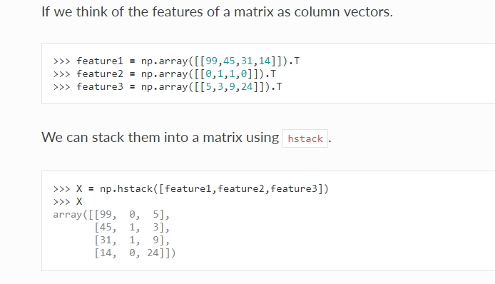

Slide 61
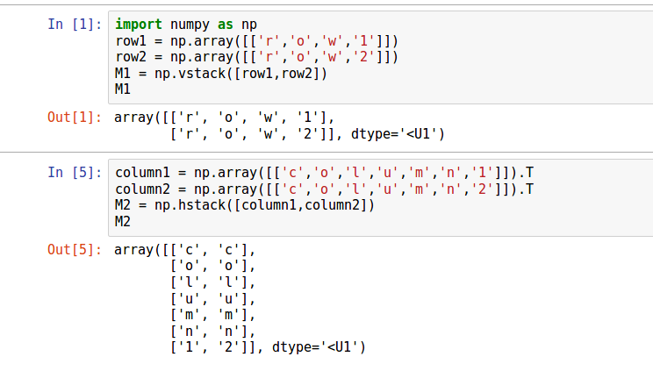
A bit about hstack and vstack:

Slide 62
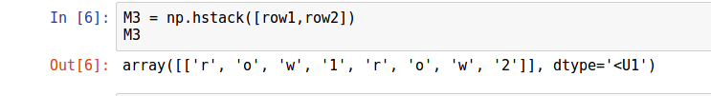

Slide 63
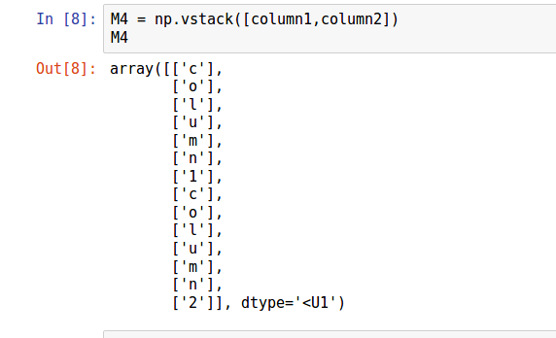

Slide 64


Slide 66

Indexing and slicing:

Slide 67

Note the difference between Python and Numpy indexing:

Slide 68

Indexing Works for setting values also

Slide 69


The Dot Product

Slide 70
The Dot Product
Note: This means that Dot Product is not commutative. If A.dot(B) exists, it does not imply that B.dot(A) also exists. Even if B.dot(A) does it exist, in general, it will have different shape and/or different values than A.dot(B)

Slide 71
The Dot Product

Slide 72

Difference Between Dot Product and Scalar Multiplication:

Slide 73

Matrix Multiplication -- A Matrix of Dot Products:

Slide 74


Slide 75


Slide 76

Array Addition Python vs. Numpy:

Slide 77

Multiplication: Python vs. Numpy

Slide 78


Slide 79

Vectorized Calculations
Suppose we have associated arrays of heights and weights and we want to calculate BMI.
We could use a for loop:
As we learned from basic python

Slide 80

Vectorized Calculations
Suppose we have associated arrays of heights and weights and we want to calculate BMI.
We could use a list comprehension:
Slightly more compact

Slide 81

Vectorized Calculations
Suppose we have associated arrays of heights and weights and we want to calculate BMI.
But the numpy was is to do it with one command, operating on the whole array in one shot:
Look! No loop!
Generally speaking, you (almost?) never need to loop through rows or columns to do calculations.

Slide 82

Generating Random Arrays:

Slide 83


Slide 84


Note: this shuffles in place and returns a ‘None’, so you can’t do this:

Slide 85

Random.choice:
Defaults to with replacement

Slide 86

Sort()
The scores got sorted, but they lost their connection to the names

Slide 87

Argsort() Example

Slide 88

Argsort() Example

Slide 89

Note that this does not work in python:

Slide 90

Some other math functions:

Slide 91


Slide 92

Solutions to Gene Expression Exercise

Slide 93


Slide 94


Slide 95


Slide 96


Slide 97




Slide 98

Physical Interpretation of the Dot Product:

Slide 99


Slide 100

Difference between Inner Product and Outer Product

Slide 101

Need to define Rows and Columns:

Slide 102


Slide 103


Slide 104


Slide 105


Slide 107


Slide 108


Slide 109


Slide 110


Slide 111


Slide 112
Overview
.
Day 1
Scalars, Vectors and Matrices
Matrix Operations
Linear Algebra I
Day 2
Linear Algebra II
Matrix Decomposition
PCA and SVD
Day 3
Distances
Similarities
Calculus

Slide 114
Measures of Distance:
Euclidean
Cosine
Manhattan
Orthodromic
 | Cats | Dogs | Horses | Monkeys
A | 8 | 2 | 4 | 2
B | 8 | 1 | 5 | 2
C | 4 | 1 | 2 | 1

Slide 115
Measures of Similarity:
Euclidean
Cosine
Manhattan
Orthodromic

Slide 116
Calculus:
Derivatives:
Finding the slope of a line tangent to a curve
Integrals:
Finding the area under a curve

Slide 117
Example:
Decelerating to a stop
x = f(t)
Speed = x’ = dx/dt = 1st derivative of position with respect to time
Acceleration = x’’ = d2x/dt2 = 1st derivative of velocity with respect to time = 2nd derivative of position with respect to time
Jerk = x’’’ = d3x/dt3 = 1st derivative of acceleration = 2nd derivative of velocity, 3rd

Slide 118
Example:
Cumulative Probability Function

Slide 119
Derivation:
Constants
Polynomials
Sum Rule
Difference Rule

Slide 120

Find the derivatives:

Slide 121

Find the integrals:

Slide 122


Product Rule:

Slide 123


Quotient Rule:

Slide 124

Solve f’(x) using the quotient rule:

Slide 125

Chain Rule:

Slide 126

Solve f’(x) using the product rule, the chain rule and expansion:

Slide 127

Find the Partial Derivatives with respect to x and y:

Slide 128

Find the Partial Derivatives with respect to x

Slide 129
Measures of Error:
Net Error
Mean Absolute Error
Mean Squared Error
Root Mean Squared Error

Slide 130
What do we want to do with Error?

Slide 131
What do we want to do with Error?
Minimize it!!!

Slide 132
A mini version of the Zillow Problem
 | Bedrooms | Bathrooms | Square Feet (thousands) | Sales Price (hundred thousands)
House_0 | 3 | 3 | 3 | 3.5
House_1 | 3 | 2 | 2.5 | 3.0
House_2 | 4 | 3 | 3.2 | 4.25
House_x | 4 | 4 | 3.1 | Predict

